Slide 1
Spring and Hibernate
Suleman Khurram

Slide 2
What is Spring framework?
Spring is a lightweight framework.
It can be thought of as a framework of frameworks because it provides support to various frameworks such as Struts, Hibernate, Tapestry, EJB, JSF, etc.
The framework, in broader sense, can be defined as a structure where we find solution of the various technical problems.

Slide 3
What is Spring framework? (continued)
The Spring framework comprises several modules such as IOC, AOP, DAO, Context, ORM, WEB MVC etc.

Slide 4
Inversion Of Control (IOC) and Dependency Injection
These are the design patterns that are used to remove dependency from the programming code.
They make the code easier to test and maintain.
Dependency injection (DI) is the concept in which objects get other required objects from outside.

Slide 5
Inversion of Control (IoC) means to create instances of dependencies first and latter instance of a class (optionally injecting them through constructor), instead of creating an instance of the class first and then the class instance creating instances of dependencies

Slide 6
Examples
Without IoC and DI
class Employee{
Address address;
Employee(){
address=new Address();
}
}
With IoC and DI
class Employee{
Address address;
Employee(Address address){
this.address=address;
}
}

Slide 7
Advantages of Spring Framework
Predefined Templates
Loose Coupling
Easy to test
Lightweight
Fast Development
Powerful abstraction
Declarative support

Slide 8
Architecture
Spring could potentially be a one-stop shop for all your enterprise applications.
However, Spring is modular, allowing you to pick and choose which modules are applicable to you, without having to bring in the rest

Slide 9
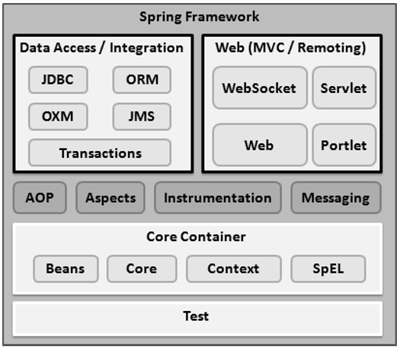

Slide 10
Core Container
The Core module provides the fundamental parts of the framework, including the IoC and Dependency Injection features.
The Bean module provides BeanFactory, which is a sophisticated implementation of the factory pattern.
Context module
SpeL module

Slide 11
Data Access/Integration
The JDBC module provides a JDBC-abstraction layer that removes the need for tedious JDBC related coding.
ORM module.
OXM module.
The Java Messaging Service JMS module.
Transaction module

Slide 12
AOP, Aspects and Instrumentation
These modules support aspect oriented programming implementation where you can use Advices, Pointcuts etc. to decouple the code.
The aspects module provides support to integration with AspectJ.
The instrumentation module provides support to class instrumentation and classloader implementations.

Slide 13
Web
This group comprises of Web, Web-Servlet, Web-Struts and Web-Portlet. These modules provide support to create web application.

Slide 14
Hibernate framework
Hibernate is a Java framework that simplifies the development of Java application to interact with the database.
It is an open source, lightweight, ORM (Object Relational Mapping) tool.
Hibernate implements the specifications of JPA (Java Persistence API) for data persistence.

Slide 15
What is ORM?
An ORM tool simplifies the data creation, data manipulation and data access. It is a programming technique that maps the object to the data stored in the database.
The ORM tool internally uses the JDBC API to interact with the database.

Slide 16
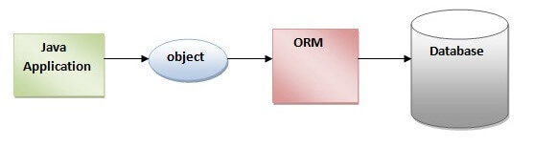

Slide 17
What is JPA?
Java Persistence API (JPA) is a Java specification that provides certain functionality and standard to ORM tools. The javax.persistence package contains the JPA classes and interfaces.

Slide 18
Advantages of Hibernate Framework
Open Source and Lightweight
Fast Performance
Database Independent Query
Automatic Table Creation
Simplifies Complex Join
Provides Query Statistics and Database Status

Slide 19
Hibernate Architecture
The Hibernate architecture includes many objects such as persistent object, session factory, transaction factory, connection factory, session, transaction etc.
The Hibernate architecture is categorized in four layers.
Java application layer
Hibernate framework layer
Backhand api layer
Database layer

Slide 20
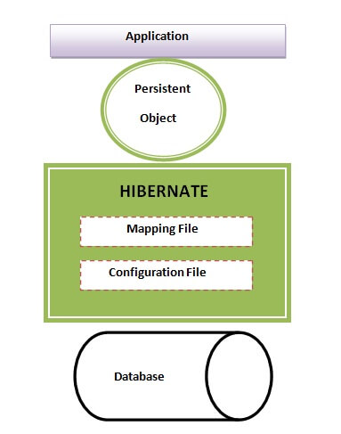

Slide 21
Practical Implementation
We will be using following tools and configuration for developing a Spring based applications
Spring
Hibernate
Maven

